Slide 1

MmWave MU-MIMO for Aerial Networks
Travis Cuvelier and Robert W. Heath Jr.
Wireless Networking and Communications Group
Department of Electrical and Computer Engineering
The University of Texas at Austin
This work was supported in part by the Lockheed Martin Corporation, the National Science Foundation under Grant No. CNS-1731658, and an Engineering Doctoral Fellowship from the University of Texas at Austin Cockrell School of Engineering.
Thanks to Prof. Nuria Gonzalez-Prelcic for some of the graphics!
Notes:
I’m Travis Cuvelier, I’m a graduate student with the Wireless Networking and Communication Group at the University of Texas at Austin. I’ll be presenting a joint work with my advisor, Prof. Robert Heath Jr., on millimeter wave mulituser MIMO for aerial networks.

Slide 2
Motivation
System model
MU-MIMO digital received signal model
Channel model parameters
Analytical framework
Simulations and numerical results
Notes:
I’ll to motivate aerial networks as an interesting and emerging domain for wireless communications. I’ll then move into the system model, which, to be honest, is really the main contribution of this paper. It includes what I claim is an accurate path loss model for A2A millimeter wave communication, taking into account atmospheric attenuation at mmWave frequencies as well as the mutual impedance of antenna arrays. Moving from there, I’ll present a stochastic geometry framework that we use to estimate achievable rates. I’ll conclude with these numerical results. I hope to show you that mmWave is a promiseing technology for delivering gigabit connectivity in next-gen aerial networks.

Slide 3
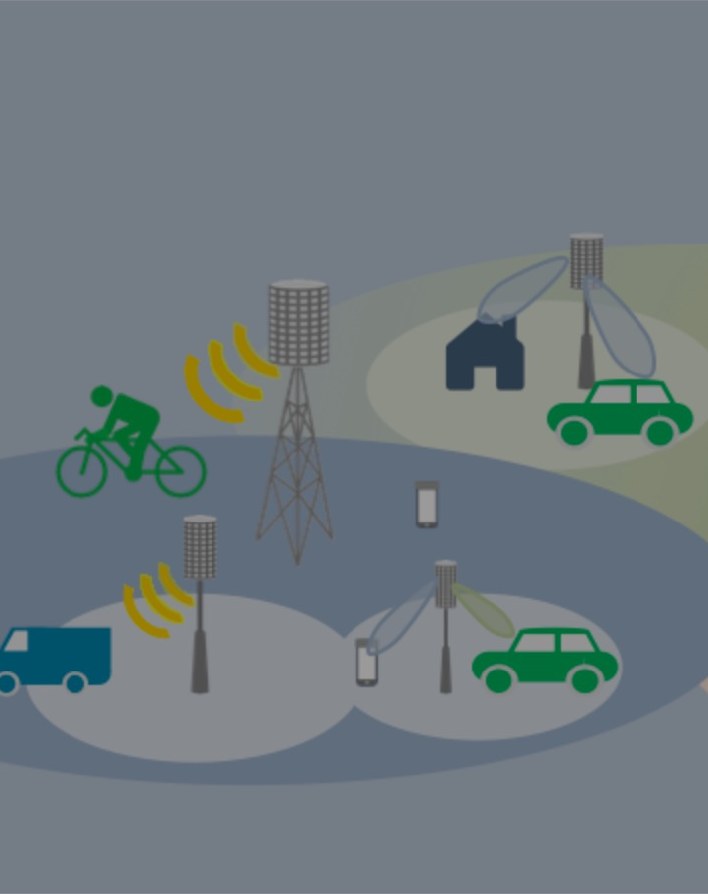
Motivation
www.wncg.org

Slide 4

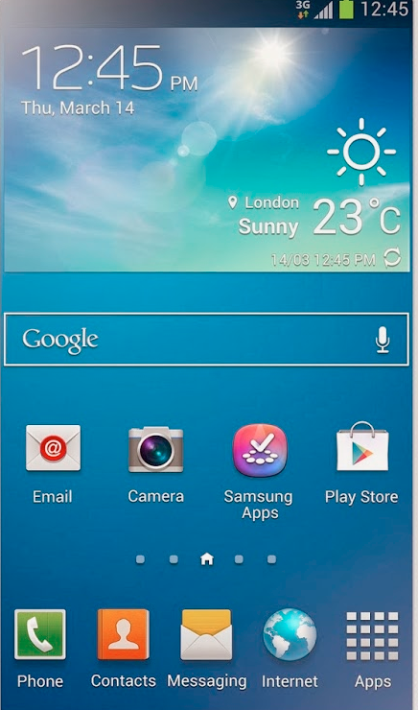
Motivation
Aerial node
Mobile cellular infrastructure
Environmental monitoring
Team of UAVs
Sensor fusion via sensor data exchange
Personal transport
Positioning and navigation
Communications relay
High data rate networking between manned and unmanned aerial vehicles enables revolutionary applications
Notes:
So I guess maybe at this point it’s obvious that unmanned aerial vehicles/systems (UAVs) are an emerging technology with a with all the stuff you read online about Uber and Amazon delivering people and packages with drones. Enabling drones to communicate with one another, or with other aircraft, could open up a lot of opportunities in things like sensor fusion and distributed control, for instance in an aerial swarm. People have written about using UAVs to provide an temporary cellular coverage in the event of a disaster to users on the ground, and several have considered using air-to-air links as a wireless backhaul.
References….
So if you agree with me that engineering aerial networks with high data rates is a problem worth solving, the next question we have to ask is how to actually do the engineering.

Slide 5
Millimeter wave (mmWave) MIMO
Exploits RF frequencies (> 30 GHz) higher bandwidths 200 MHz to 4 GHz
Large antenna arrays with a small form factor
Baseband
RFain
RF
Chain
DAC
New MIMO architectures
Analog
beamforming
Baseband
RF
Chain
RFain
ADC
Narrow beams enable secure TX and RX and reduced interference
Analog
beamforming
mmWave offers a wealth of spectrum, but requires new engineering
Notes:
At this point its probably not controversial to say that the spectrum below 6 GHz is crowded, and unfortunately limited bandwidth means limited data rates. Millimeter wave offers a large amount of available bandwidth, although it presents additional engineering challenges. Due to a shrinking aperture, the use of a large number of antennas is necessary. Millimeter wave is characterized by the use of narrow beams for communication, which can be beneficial from a physical layer security perspective but presents difficulties when trying to establish and track links. In aerial systems, since users will have 3 dimensions of freedom with respect to their position, 2-dimensional antenna arrays will be critical. Furthermore, and we’ll talk a little more about this later, while the RF and circuits people can build arrays with a lot of antennas, we can’t support as many RF chains [[[Integration is difficult, as is the power loss]]]– so the beamforming is in general done in a two stage analog and digital process.
Anthat d so, to reiterate, the purpose of this talk is mostly to convince you these are problems worth solving- that is to say, I’ll try to make the case that millimeter wave is a promising technology for delivering gigabit connectivity in next generation aerial networks.

Slide 6
System model
www.wncg.org

Slide 7
Network topology and MIMO configuration
Planar analog subarray of patch antennas
Access point (AP)
RF Chain
…
Digital Beamforming
N_{ue} subarrays
Phase and magnitude variable with full precision
RF Chain
UPA top view
N_{UE} low complexity aerial users (UEs)
RF Chain
Notes:
We assume a scenario where multiple airborne users communicate with a central aerial access point in a star network topology. All of my discussion today is going to be in the uplink scenario, that is to say communication from the aerial users to the access point (AP). In terms of the antenna configurations, as I mentioned before at millimeter wave we typically have less RF chains than antennas, so the beamforming is split into analog and digital parts. In a subarray based architecture like the one in the green box, each RF chain is connected to a subarray of antennas with analog beamforming.. Digital beamforming is performed across the signals for each chain. In our case, I’m going to assume that the access point has such a hybrid architecture, and that the number of subarrays is equal to the number of users being served.
The red box shows the architecture for the aerial users. The aerial users are assumed to be lower complexity, and to have only one RF chain and thus ONLY analog beamforming.
We assume the AP subarrays and UE arrays are uniform planar arrays of patch elements, and that’s illustrated in the dashed box. Another assumption I’m going to make (probably the worst of my assumptions) is that the analog beamformers can vary both phase and magnitude with full precision. This is a very strong assumption, and could be relaxed in future work. This doesn’t impact the channel model, but plays a role in the beamforming and in the rate analysis.

Slide 8

Other assumptions
High altitudes, frequencies so LOS dominates
Assume perfect frame, carrier synchronization among users
Limited acceleration
UEs know angular location of AP and vice versa
Notes:
It’s been shown in the literature that for communication between aircraft, the non line of sight component diminishes with altitude. Given that we’re communicating with narrow beams at the relatively high mmWave frequencies, we expect the NLOS component to become very small at even lower altitudes. We assume that the network is at a high enough altitude (and frequency) such that the line-of-sight signal component dominates. Furthermore, we’ll assume perfect frame and carrier synchronization among the users. This allows us to extend our single path channel model to the broadband case. We assume that the aircraft have limited acceleration over the coherence interval. For LOS communication at constant velocity, the effects of Doppler fall into the carrier frequency offset term, and thus by our prior assumption we assume they’ll be mitigated.
The last thing I’m going to assume is that the AP has side information and knows UEs angular bearing. Likewise, the UEs all know the angular location of the AP

Slide 9
System model
MU-MIMO received signal model
www.wncg.org

Slide 10
Key contributions: LOS received signal model
Model mutual coupling of antenna arrays
Model atmospheric attenuation with realistic parameters
Atmospheric gas absorption
Weather effects both received signal and noise powers!
Cloud attenuation
More path loss (eg. 60 GHz)
Less path loss (eg. 38 GHz)
Hydrometeor scattering
More accuracy at cost of increased complexity [2]
[2] M.T. Ivrlac and J. A. Nossek, “Toward a circuit theory of communication,” IEEE Trans. Circuits Syst. I, Reg. Papers, vol. 57, no. 7, pp. 1663-1683, July 2010
Notes:
So just to give you a quick rundown, I think that one of the main contribtions of this model is to accurately account for the mutual coupling beteween closely spaced antenna elements, which is more preminent in line-of-sight communication with UPAs than, for instance in multipath communication with ULAs. The other main contribution is an accurate accounting of atmospheric effects- it turns out that weather effects both the received signal and noise powers.
So you know I’ve already mentioned that I assumed LOS communication, and obviously, in a sense, an LOS model is the arguably the complicated channel one could have. Like a good engineers we worked hard to make this one more complicated. The key contrions, as I see them, of our channel model is that it accounts for mutual coupling between closely spaibutced antennas, and includes an accurate accounting of atmospheric attenuation effects.
Mutual coupling is essentially present in any realizable ULA or UPA. In the standard mimo model, that is to say y = a matrix Hx + noise, this coupling is neglected. I think the inspiration for this is because if you have a uniform linear array of critically spaced (ie lambda/2) isotropic radiators, there is no coupling. When the elements are not isotropic is when you get coupling. In a UPA, however, there is coupling even in the isotropic case. The main reason is that elements that are diagonal from one another have a separation that isn’t an integer number of half wavelengths, as you can see in the figure on your left. Again, since the elements aren’t isotropic, there’s even more coupling. In line-of-sight communication, this coupling plays a preeminent role in signal propagation, especially when using UPAs.
%%%%%The idea of including this coupling in a channel model isn’t new- in 2010 Ivrlac and Nossek published the article on the screen “towards a circuit theory of communication” where they account for this coupling in terms of circuit parameters. I am bad at circuits and am marginally better when it comes to antenna theory- our model obtains results analogous to those in their paper but is cast in terms of antenna parameters, namely the gain pattern, that are relatively easy to compute.
In terms of atmospheric attenuation, its notable that oxygen, nitrogen, and water vapor absorb millimeter wave radiation. Oxygen absorbtion is what causes the high path loss at 60 GHz. Furthermore, there is absorbtion and scattering from hydrometeors such as suspended liquid water in clouds as well as precipitation. As it turns out, since things that absorb the radiation incoherently re-radiate it, the absorbtion processes contribute to the receiver noise. We account for both of these effects.

Slide 11
Scalar digital channel from one UE to AP subarray
Channel from UE k to subarray i
Gaussian noise
Received signal at AP subarray i
Symbol transmitted by UE k
Large scale term
Small scale term
Notes:
So the first think I’m going to do is derive a digital channel from a single UE to a single AP subarray (that is to say, the signal that arrives on a single RF chain at the AP). The equation itself is pretty self explanatory, but what’s important to note is that we’re going to decompose the scalar channel h into large and small scale terms. Alpha, the large scale term, is going to capture power transfer, and the e to the j Beta term will account for the phase.

Slide 12
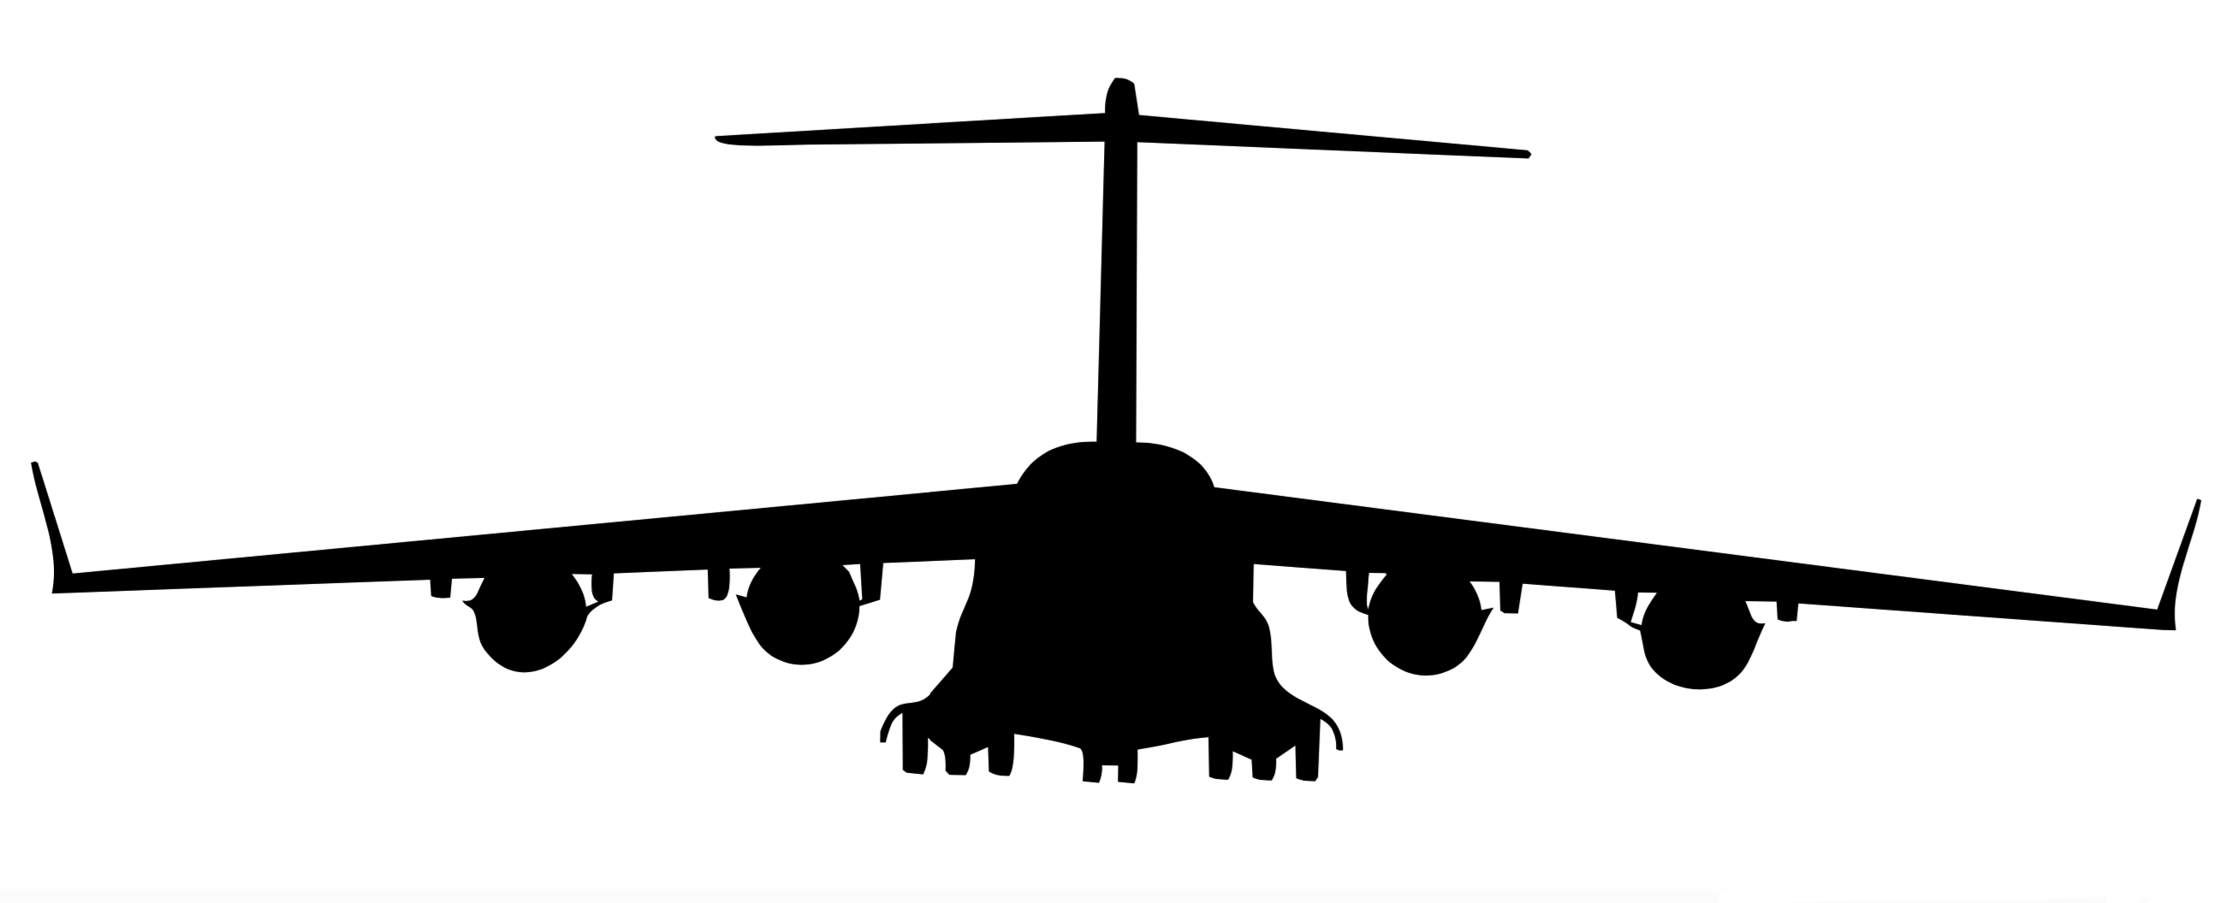
Model for communication from UE to AP subarray
Assume IID uniform random phases
Small changes in canting/vibration change path lengths order of 𝜆
Free Space Propagation (Friis):
RX power
TX power
Gain patterns depend on angular bearing, beamforming weights
Free space + atmospheric loss
Specific attenuation
Notes:
Most of this is going to focus on deriving alpha, the large scale term, which is where the mutual coupling and atmospheric stuff comes in. I’ll actually just quickly mention the small scale stuff first. Essentially, I claim that you can pretty much assume beta to be a uniformly random phase, and its reasonable to assume that the phases we receive on different subarrays are independent, so long as the subarrays aren’t placed too close together. This is pretty much due to the fact that aircraft are pretty mobile with respect to the millimeter scale wavelength, you can see in the figure in the blue box that those two path lengths are quite different, and you could imagine that if the aircraft were to tilt, vibrate, or move little bit, we’d get a different relationship. I’d be lying if I didn’t also say that this assumption was convenient.
Now let’s focus on the term alpha, and the unfortunate equation in the red box. That equation is well known and is called the “Friis free space propagation equation”. It caputres the the relationship between physically radiated power and received power for two antennas, or antenna arrays, in terms of the gain patterns of the transmitted and received system, the aperature (that’s the lambda squared term), and losses.
We’re going to look into those gain functions in another slide, but its notable that they’re functions of the communication bearings, and, in a phased array system, the beamforming weights. These gain patterns incorporate the effects of mutual coupling- this equation concisely and accurately captures the physics of LOS wireless power transfer
Losses are also a little different a mmWave. Typically we all rlearned to set that term L(r ) equal to 1/r^2, but at mmWave due to atmospheric effects that 1 over r squared is mutlipled by an additional exponential damping effect.
Now based on this frriis equation, we’re going to set alpha equat

Slide 13
Extension to multiple users, multiple subarrays
Bandwidth
Ignores coupling between elements on different subarrays
Symbols from N_{UE} users
Received signal from each of N_{UE} subarrays
IID uniform random phases
Bearing from AP to UE k
i^{th} subarray array weights
Bearing from UE k to AP
k^{th} user array weights
Range of user k
Notes:
So its pretty easy to extend this to mutliple users and multiple AP subarrays (RF chains) given the assumptions I already mentioned. I am going to mention one thing that looks innocuous though, and thats the fact that I assuemd the noise to be spatitally white. This ignores coupling between elements on different subarrays. This is an approximation, however it could be quite accurate depending on subarray placement.

Slide 14
Greedy uplink beamforming
Choose analog beamforming weights to maximize diagonal terms of .
Subarray k maximizes gain in direction of UE k
Solve generalized Rayleigh quotient problems of the form:
Users maximize gain in direction of AP
Linear digital combining at AP (e.g. MMSE, ZF, identity)
Notes:
So the channel model I just mentioned lends itself to a pretty intuitive heuristic beamforming strategy. Remember my ”digital channel” is a function of my analog BF weights. Essentially, I try to choose these weights to maximize the magnitude of the diagonal elements of that matrix I showed you. The users all maximize their gain patterns in the direction of the access point. Each user is associated with a particular subarray (remember 1 subarray per user), and that subarray similarly maximizes its gain in the direction of the associated user. Of course, to do this maximization, the users need to know where the AP is, and the AP needs to know where the users are in angle space. Other than that, the maximization is just a rayleigh quotient problem that’s easy to solve. After doing this analog beamforming, we can do whatever digital beamforming we want across the RF chains- I show results for MMSE and essentially not doing any digital beamforming at all.

Slide 15
System model
Channel model parameters
www.wncg.org

Slide 16
Specific attenuation [3]
Gaseous attenuation computed at typical surface conditions.
[3] R.W. Heath, T. Cuvelier, J. Rodriguez-Fernandez, N. Gonzalez-Prelcic, “Millimeter wave for aerial vehicles” preprint
Notes:
So remember that the term describing mmWave power loss with distance is the one in the blue box. It turns out that gamma, the specific attenuation parameter, can pretty mcuh be decomposed into contributions from three different processes- namely gasous absorbtion (that’s diatomic oxygen, water vapor, ozone and nitrogyn), and absorbiton and scattering from suspended liquid water (clouds and fog) and precipitation. This bar chart compares these losses with the standard free space path loss (proportional to lambda^2/r^2. I’ve assumed a heavy fog for the fog bar, and a violent downpour for the rain one. These atmospheric losses are exponential with distance, which means of course they catch up with you as you get far away. The chart on the left is for 1 km, and the right shows 10 km.

Slide 17
Specific attenuation
Can use standardized reference atmospheres to compute gaseous attenuation at altitudes
Generally less attenuation at higher altitudes!
Notes:
Esoteric code available…

Slide 18
Noise
Nyquist’s noise formula:
Extrinsic noise
Intrinsic noise
Relatively easy to upper bound T_{ant} by estimates based on surface atmospheric parameters
Bound tight when communicating along horizontal, at frequencies near 60 GHz
Conditions that increase atmospheric attenuation increase extrinsic noise
In a state-of-the-art receiver, extrinsic noise ~20% of total noise at 60 GHz
Notes:
So I’ll be quick, but the last thing I want to mention is noise. Noise in recievers comes from sources internal to the reciever itself, as well as from external sources. It turns out that the same conditions that cause increased atmospheric attenuation increase the extrinsic noise. In mmWave aerial networks, LOS paths through the atmosphere make this even more relevant.
Now modeling this is actually kind of intense, in fact the noise variances actually depend on the beamforming. It is easy, though , to upper bound the extrinsic noise. We essentially consider the extrinsic noise to be equal to this upper bound (called the atmospheric mean radiaiting temperature) irrespective of the beamforming. This is most accurate at 60 GHz and when communication occurs along the horizontal.

Slide 19
Analytical framework
www.wncg.org

Slide 20
Sampling realizations of H_{UL}
Distribute users IID uniformly in a spherical sector
UE arrays face straight up, AP array faces straight down
Notes:
Place AP at origin. Uniform distribution of users, antenna arrays face along z axis facing one another.

Slide 21
Sampling realizations of H_{UL}
Given analog beamforming strategy, can compute H_{UL} based on geometry
Given digital beamforming strategy, can compute MU-MIMO capacities
Average capacities over many realizations of geometry to estimate achievable rates

Slide 22
Numerical results
www.wncg.org

Slide 23
Simulations
Waveform/MIMO parameters
Bandwidth | 2 GHz
TX power, P_{tx} | 10 W
AP subarrays | 4x4
UE arrays | 2x2
Radiator | Patch
Environmental Parameters
Atmosphere | Mid-latitude summer surface
Rain/fog | None
T_{ant} | 276 K
RX noise figure, η | 7.1 dB
Radiator | Patch
Geometry/simulation parameters
r_{min} | 0 km
r_{max} | 1 km
𝜽_{max} | 𝜽_{max} = 30°
# of trials | 1K geometry realizations
Strategy without digital beamforming
Number of Users = Number of RF Chains
Notes:
\mathbf{y} = \mathbf{W^*y_{\text{dig}}}= \mathbf{W^*(H_{\text{UL}}s+n)} \text{ where } \mathbf{W^*} = (\mathbf{I}/\text{SNR} +\mathbf{H}^*\mathbf{H})^{-1}\mathbf{H}^*

Slide 24
Simulations
Waveform/MIMO parameters
Bandwidth | 2 GHz
TX power, P_{tx} | 10 W
AP subarrays | 4x4
UE arrays | 2x2
Radiator | Patch
Environmental Parameters
Atmosphere | Mid-latitude summer surface
Rain/fog | None
T_{ant} | 276 K
RX noise figure, η | 7.1 dB
Radiator | Patch
Strategy without digital beamforming
Geometry/simulation parameters
r_{min} | 0 km
r_{max} | 1 km
𝜽_{max} | 𝜽_{max} = 30°
# of trials | 1K geometry realizations
Number of Users = Number of RF Chains
Notes:
\mathbf{y} = \mathbf{W^*y_{\text{dig}}}= \mathbf{W^*(H_{\text{UL}}s+n)} \text{ where } \mathbf{W^*} = (\mathbf{I}/\text{SNR} +\mathbf{H}^*\mathbf{H})^{-1}\mathbf{H}^*

Slide 25
Conclusions
Rates tend to increase asymptotically
Network not interference limited when adding one RF chain per user
mmWave promising for swarms
Number of Users = Number of RF Chains
Notes:
\mathbf{y} = \mathbf{W^*y_{\text{dig}}}= \mathbf{W^*(H_{\text{UL}}s+n)} \text{ where } \mathbf{W^*} = (\mathbf{I}/\text{SNR} +\mathbf{H}^*\mathbf{H})^{-1}\mathbf{H}^*
A2A nets need high data rates of these applications- system model is different, we accounted for all this stuff, sky noise, features that make models different from
Promising for swarms, possibly for dense networks… different research challenges , how network deployed mmWave only way for high rates

Slide 26
Backup

Slide 27
The gain pattern
2-D array steering vectors:
Element radiant intensity
necessarily
positive definite
Notes:
The gain pattern is where we account for the mutual coupling

Slide 28
Aside: temporal variation
V = 966 kmph / 600 mph
Coherence time limited by beam alignment [1]
Coherence time is not fatally short, even for high velocities and narrow beams
25 meters
BW = 1°
60 GHz
For a correlation of .9, scenario has a coherence time > .5ms [1]
V = 966 kmph / 600 mph
[1] V. Va, J. Choi, and R. W. Heath, “The impact of beamwidth on temporal channel variation in vehicular channels and its implications,” IEEE Trans. On Veh. Technol., vol. 66, no. 6, pp. 5014-5029, June 2017
Notes:
While we don’t model any temporal variation in what follows, it is worth noting that the coherence time is limited by the beam alignment itself [vutha]. You might think that with these small wavelengths and aircraft that move quickly, the coherence time might be too short. This isn’t so. Let me share an extreme case. The crusing speed of a 777 is like 600 mph. The minimum coherence time would occur if two of these jets were traveling in opposite directions directly across from one another, and they were very close together (say 25 meters, which according to my pilot friend is not something that would happen). At 60 GHz, if I define the coherence time to be the point where the temporal correlation function drops to .9, using the model from [1] I get a coherence time that exceeds half a millisecond. That’s short, but if I had 2 GHz of bandwidth, I can use the channel a million times.

Slide 29
Sampling realizations of H_{UL}
Distribute users IID uniformly in a spherical sector
UE arrays face straight up, AP array faces straight down

Slide 30
Computing the rates: example
For MMSE beamforming, forming with
gives a Gaussian channel for each UE
Assuming independent encoding/decoding and Gaussian signaling, the rate available to each user u is where
and
Network sum rate: just the sum over the rates available to users
Notes:
\mathbf{y} = \mathbf{W^*y_{\text{dig}}}= \mathbf{W^*(H_{\text{UL}}s+n)} \text{ where } \mathbf{W^*} = (\mathbf{I}/\text{SNR} +\mathbf{H}^*\mathbf{H})^{-1}\mathbf{H}^*

Slide 31
Specific attenuation
Notes:
X

